Slide 1
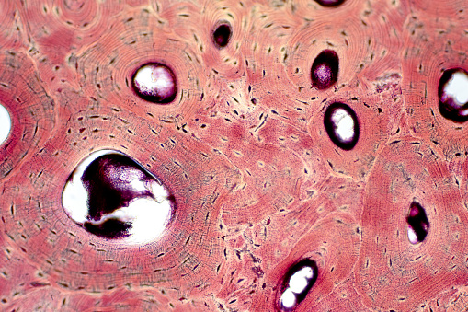
Chapter 6: Introduction to Bones
image: compact bone
Dr. Paige Morgan Laramie County Community College

Slide 2
Function of Bones
support: serves as structural framework for the body by supporting soft tissues and providing attachment points for tendons of skeletal muscles
protection: protects the most internal organs from injury ex: rib cage protects the heart and lungs; cranial bones protect the brain
assistance in movement: most skeletal muscles attach to bone; when they contract, they pull on bones to produce movement
mineral homeostasis: stores several minerals (esp. calcium and phosphorous) which contribute to bone strength and can be released into the blood to be distributed to other tissues in the body in order to maintain mineral balance
blood cell production: in certain bones, a connective tissue called red bone marrow produces red blood cells, white blood cells, and platelets in a process known as hemopoiesis red bone marrow = consists of developing blood cells, adipocytes, fibroblasts, and macrophages in network of reticular fibers; found in developing bones of fetus and in some adult bones (ex. pelvic bones, ribs, sternum, vertebrae, skull, and ends of humerus and femur)
triglyceride storage: yellow bone marrow = consists mainly of adipose cells
2

Slide 3
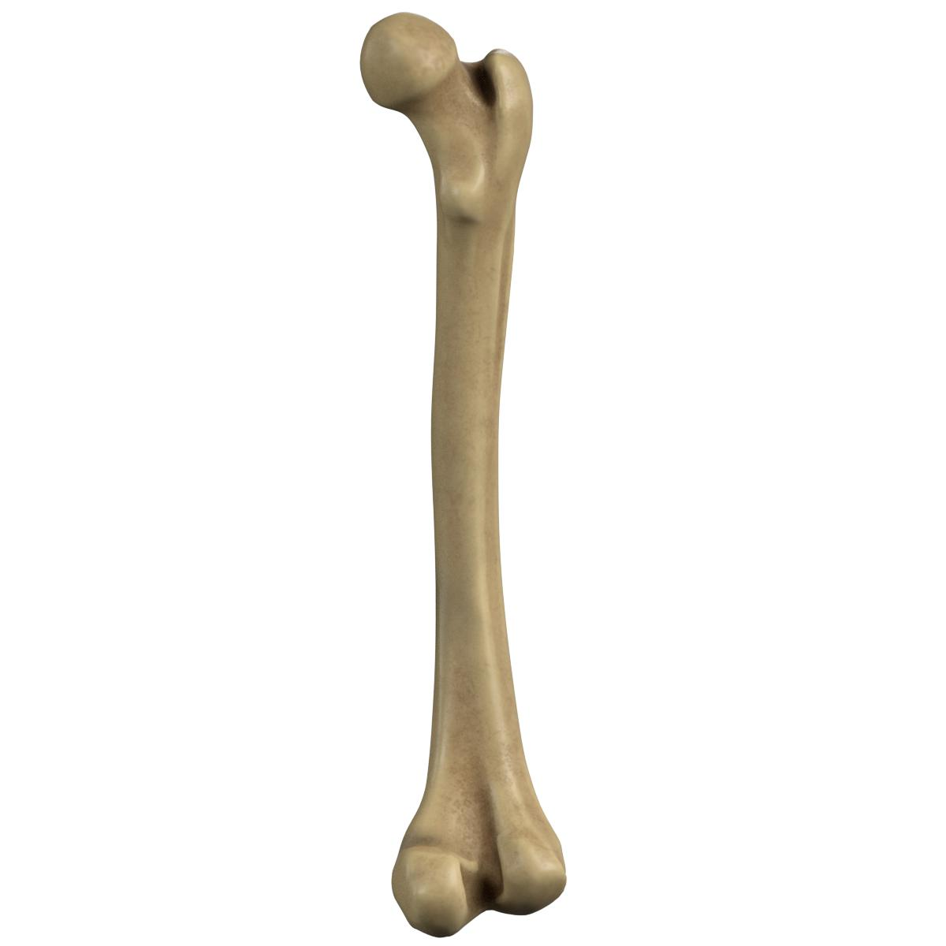
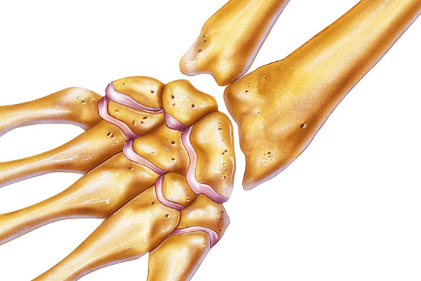
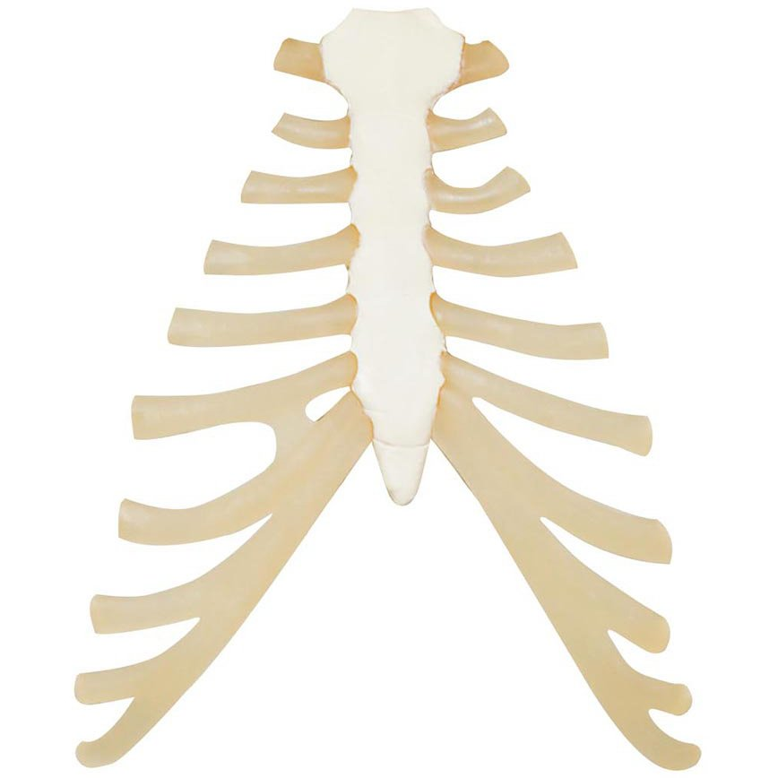
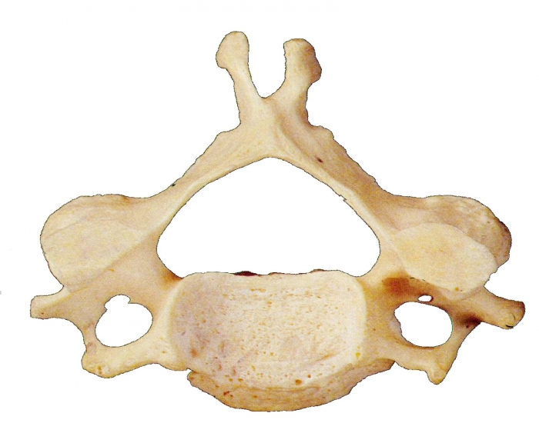
Types of Bones
long bones: have greater length than width → consist of a shaft and a variable number of extremities or epiphyses (ends) → made mostly of compact bone in their diaphyses but have spongy bone in their epiphyses ex. femur, tibia, fibula, humerus
short bones: somewhat cubed shaped; nearly equal in length and width → consist of spongy bone except at the surface, which has a thin layer of compact bone ex. carpal and tarsal bones
flat bones: generally thin and composed of two nearly parallel plates of compact bone tissue enclosing a layer of spongy bone tissue → provide extensive area for muscle attachment and protection ex. cranial bones, sternum, ribs, scapulae
irregular bones: have complex shapes and cannot be grouped into any other category ex. vertebrae, hip bones, certain facial bones, calcaneus
sesamoid bones: develop in certain tendons where there is considerable friction, tension, and physical stretch ex. patella
sutural bones: small bones located in sutures (joints) between certain cranial bones
3

Slide 4
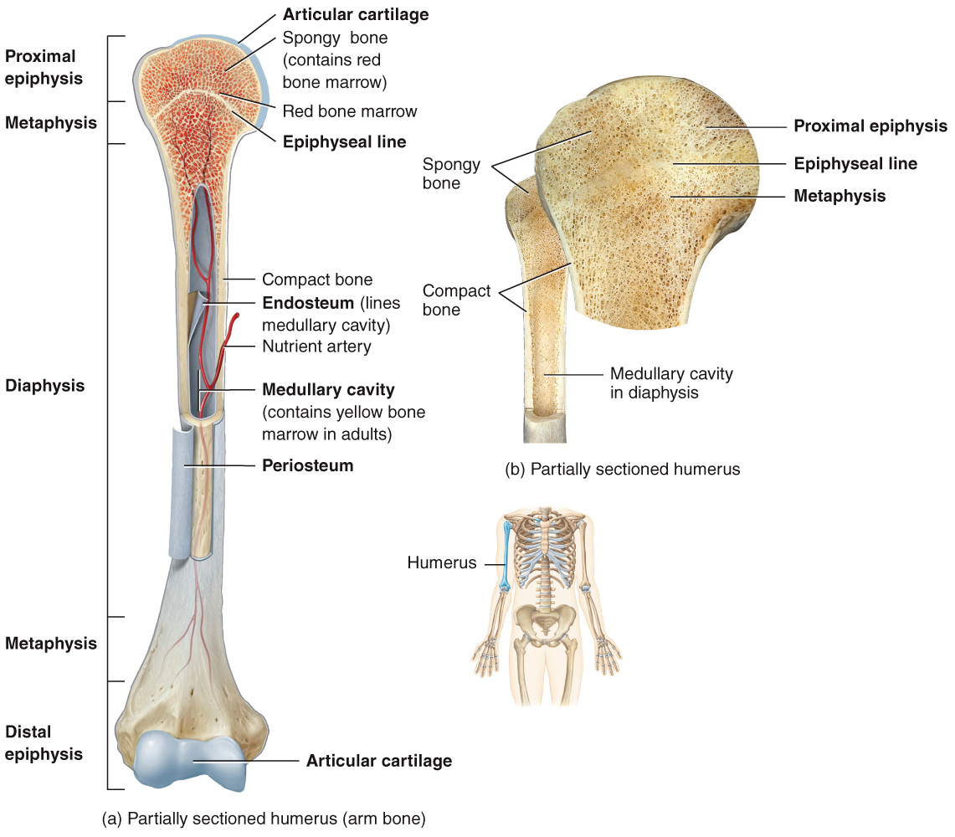
Bone Structure
diaphysis: bone shaft/body; makes up the long, cylindrical portion of the bone
epiphyses: proximal and distal ends of the bone
metaphyses: regions between the diaphysis and epiphyses → in a growing bone, each metaphysis contains an epiphyseal growth plate = layer of hyaline cartilage that allows the diaphysis of the bone to grow in length → when a bone stops growing, the hyaline cartilage is replaced with actual bone
articular cartilage: thin layer of hyaline cartilage covering the part of the bone that forms a joint (articulation)
periosteum: tough connective tissue sheath that surrounds the bone surface wherever it is not covered by articular cartilage
medullary cavity (aka marrow cavity): hollow cylindrical space containing fatty yellow bone marrow
endosteum: thin membrane that lines the medullary cavity
4

Slide 5
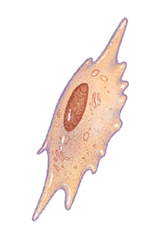
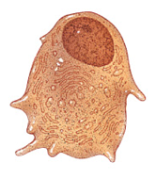
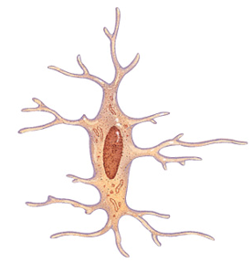
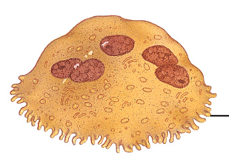
Bone Cytology
osteoprogenitor cells: unspecialized bone stem cells → these are the only bone cells to undergo cell division → the resulting cells develop into osteoblasts
osteoblasts: bone-building cells → synthesize and secrete collagen fibers and components needed to build the ECM of bone (bone deposition) → initiate calcification (hardening of bone tissue)
osteocytes: mature bone cells (main cells in bone) → help maintain daily metabolism
osteoclasts: bone-degrading cells → huge cells concentrated in the endosteum (lining the medullary cavity) → release powerful lysosomal enzymes and acids that digest bone (bone resorption)
5

Slide 6
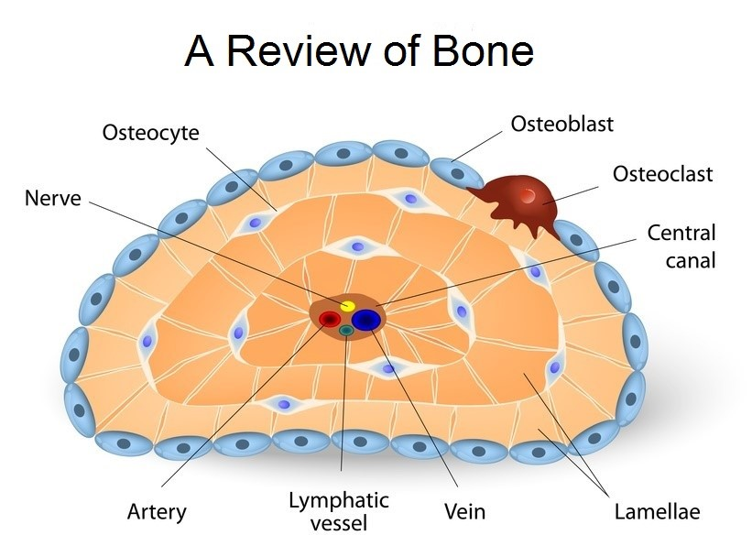
Compact Bone Tissue
compact bone tissue: provides protection and support
location: found beneath the periosteum of all bones; comprises the diaphysis of long bones
function: helps the bone resist the stress produced by weight and movement
structure: composed of repeating structural units called osteons (aka haversian systems)
6

Slide 7
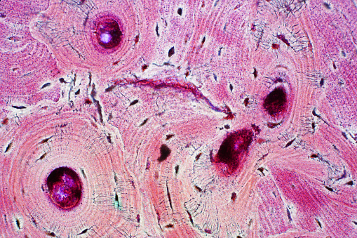
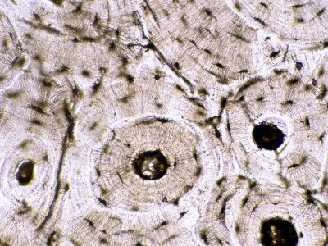
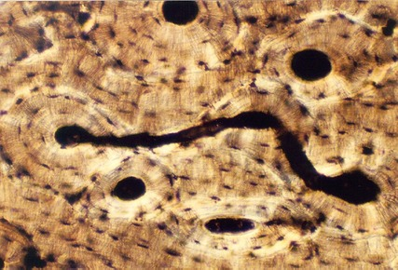
Compact Bone Tissue – Histology
7

Slide 8
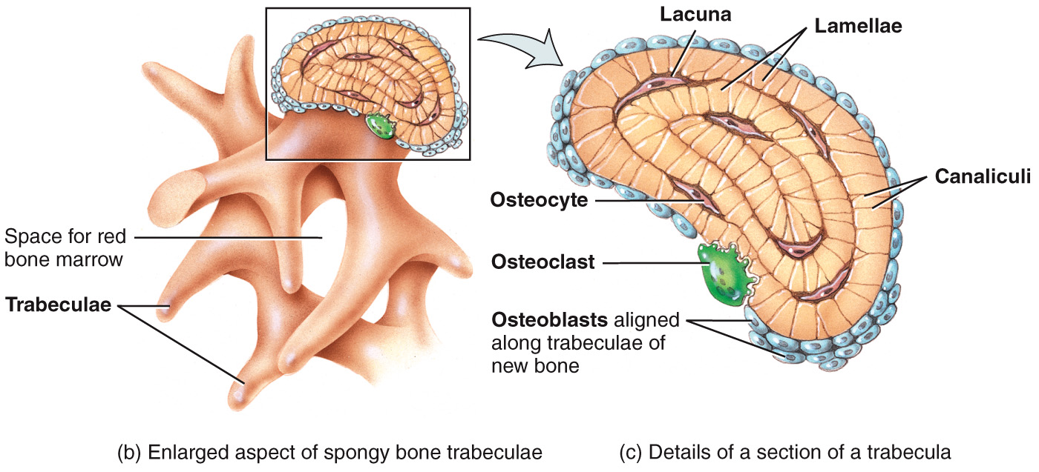
Spongy Bone Tissue
spongy bone tissue: lightweight; provides tissue support
location: in the interior of the bone, protected by a covering of compact bone
function: storage of bone marrow
structure: → consists of lamellae that arranged in irregular pattern of thin columns called trabeculae → between the trabeculae are spaces filled with red bone marrow (in bones that produce RBCs) and with yellow bone marrow (in other bones)
8

Slide 9
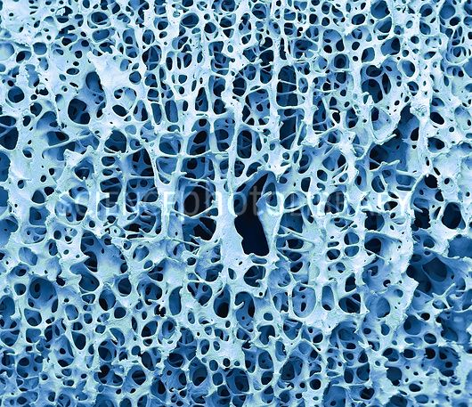
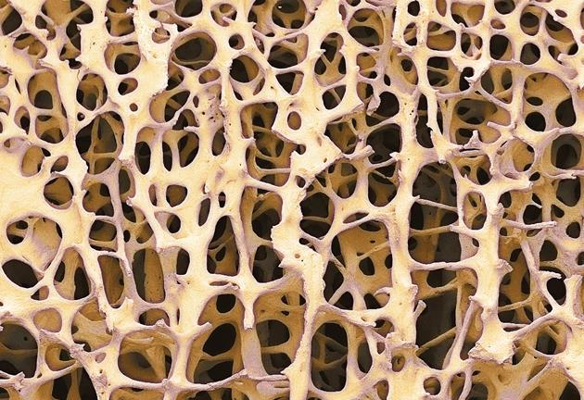
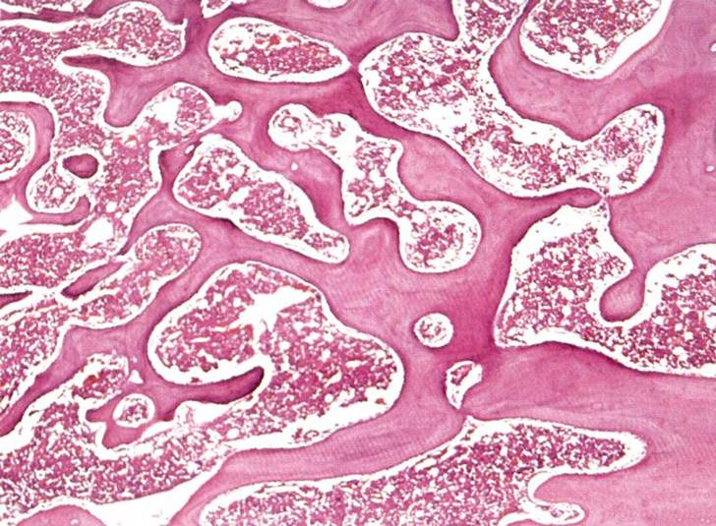
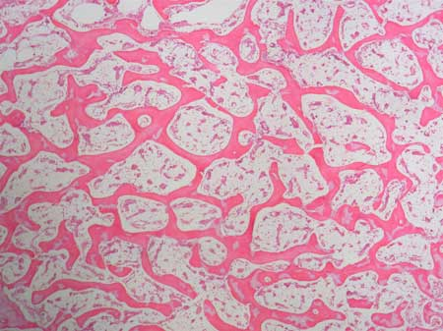
Spongy Bone Tissue – Histology
9

Slide 10
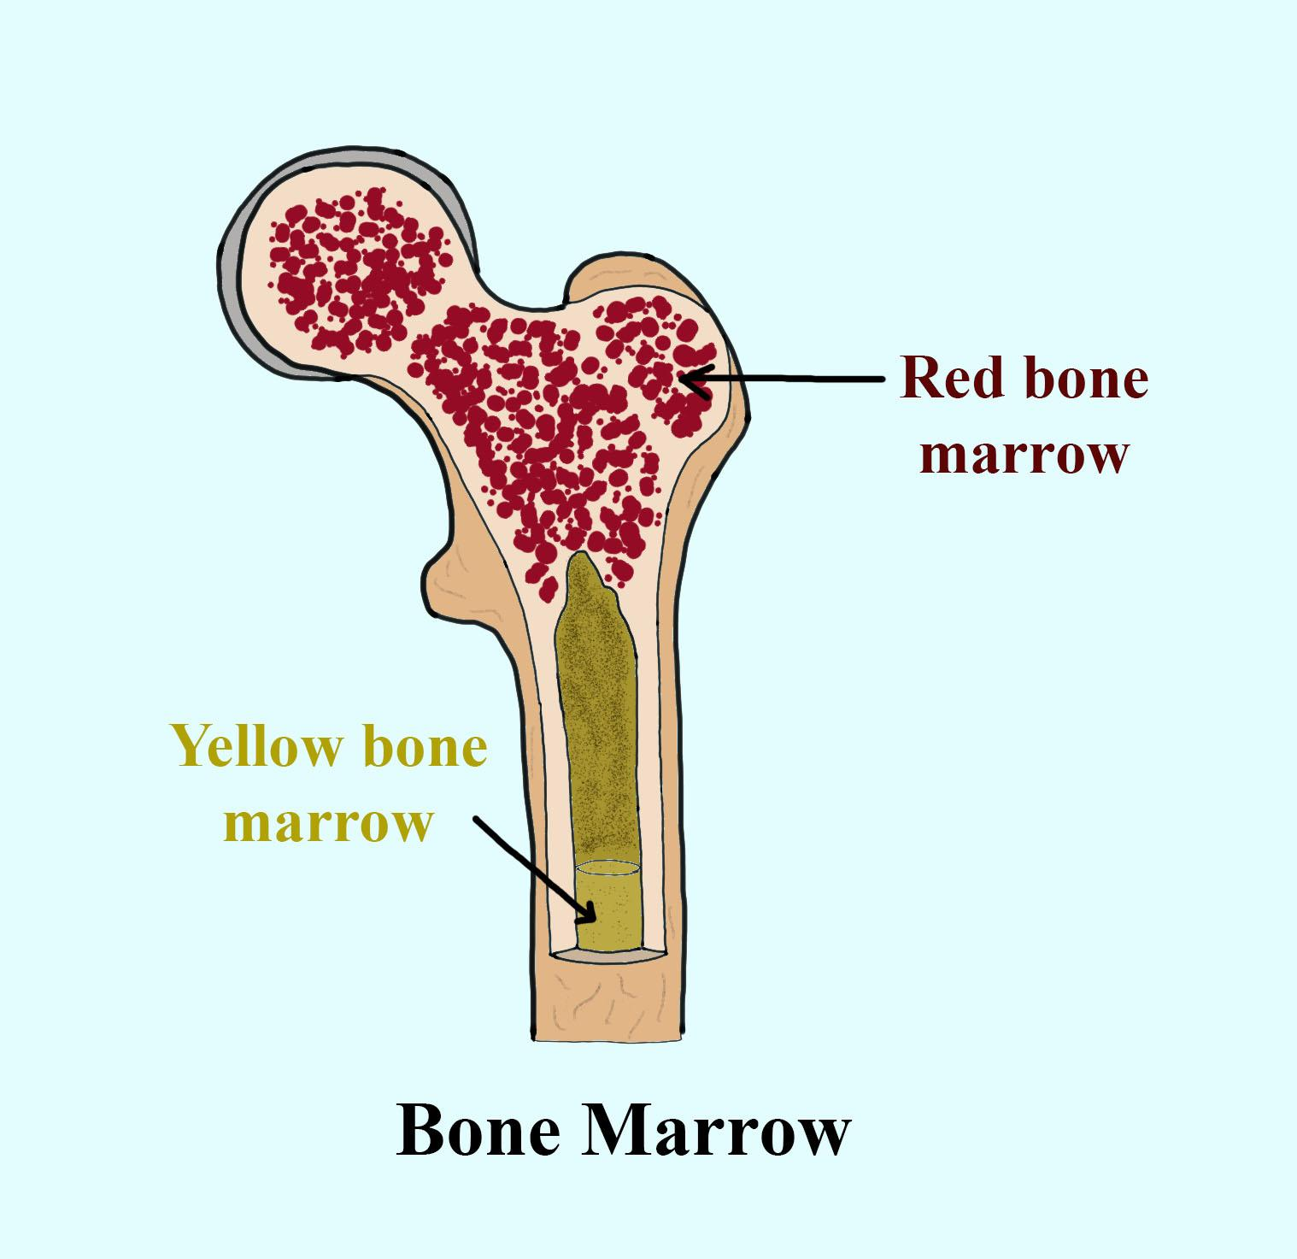
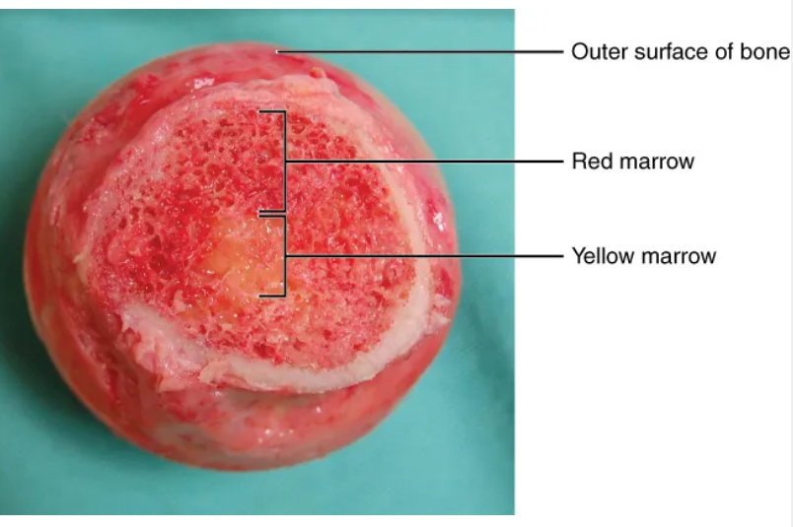
Bone Marrow
red bone marrow: → located between the trabeculae of certain bones (ex. ribs, sternum, vertebrae, long bones) → primary source of new blood cells
yellow bone marrow: → located in diaphysis of long bones like the femur, tibia, and humerus → comprised of adipocytes
10

Slide 11
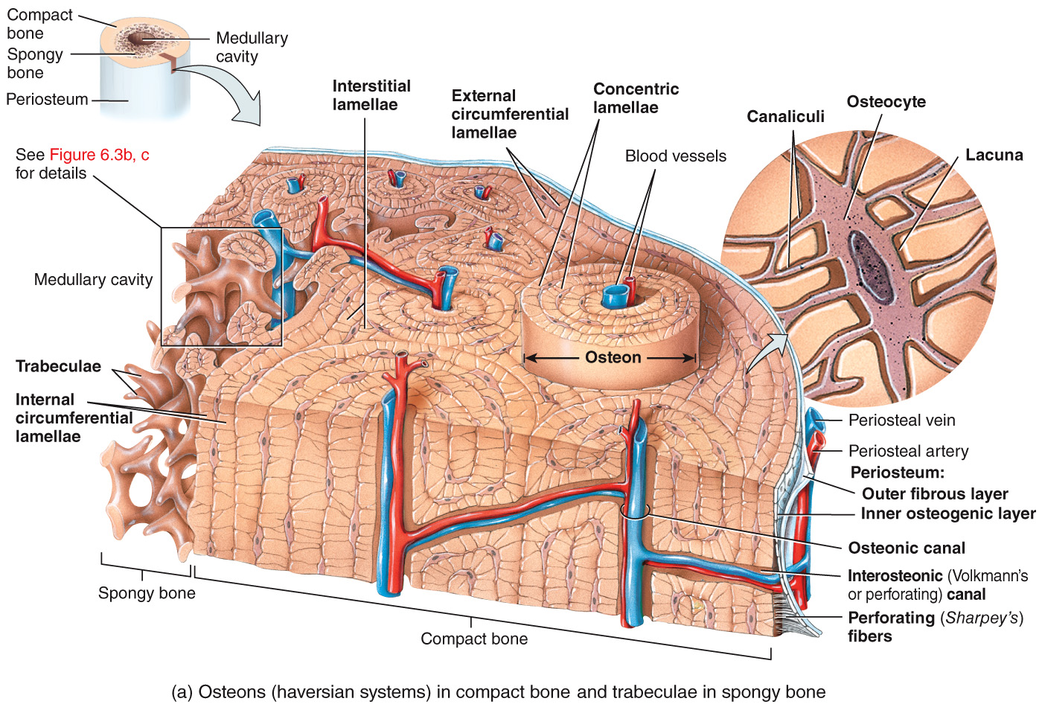
Compact vs. Spongy Bone
11

Slide 12
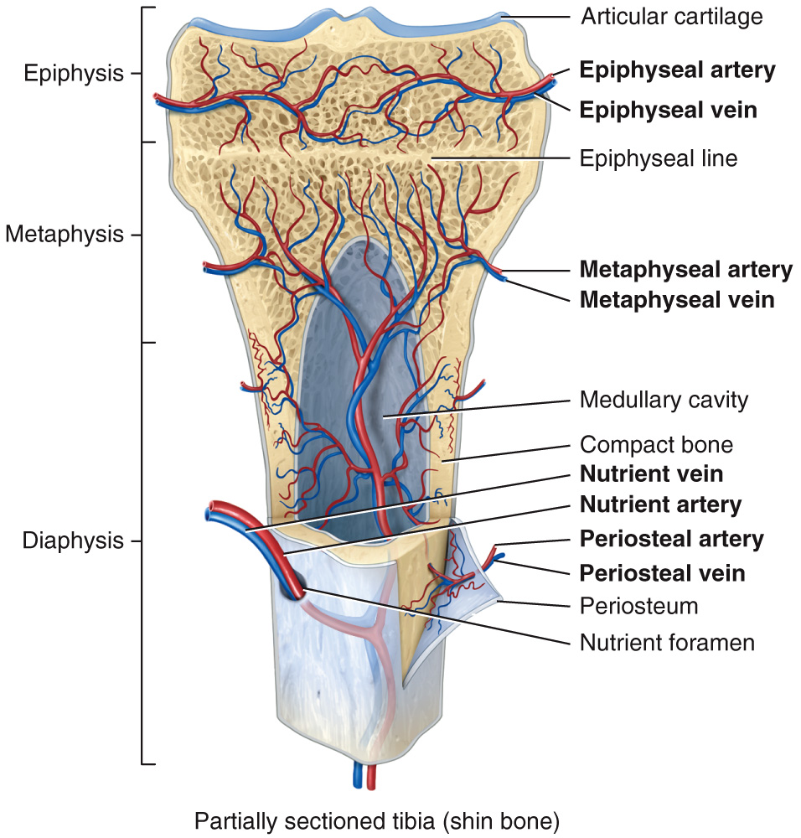
Blood Supply
12

Slide 13
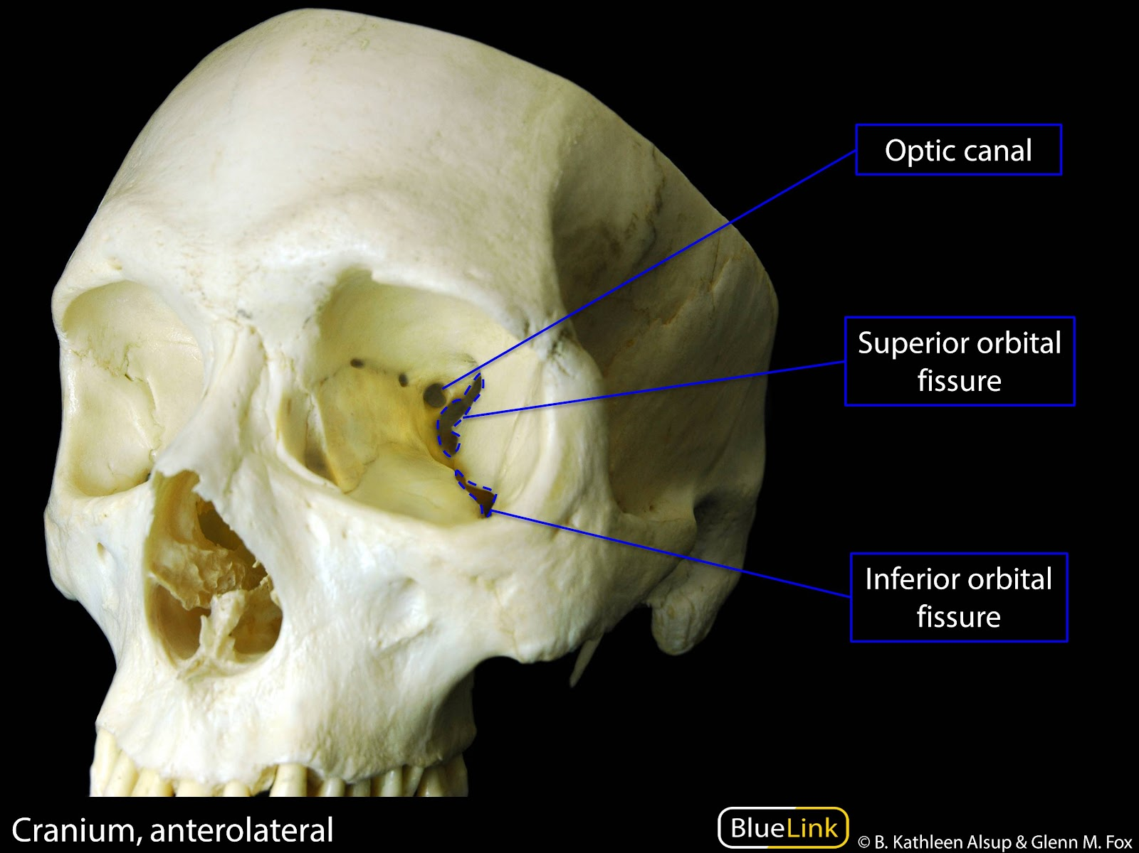
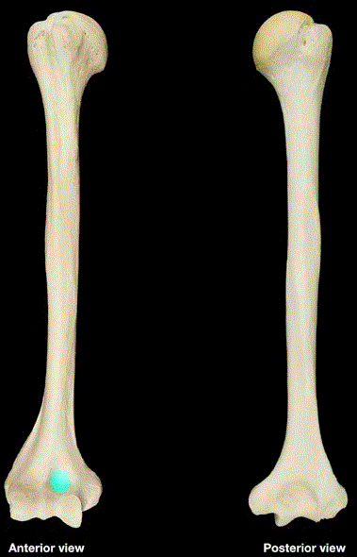
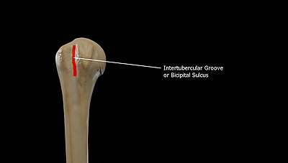
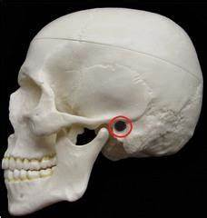
Some Vocabulary
[1] depressions and openings
fissure → narrow slit between adjacent parts of bone thru which nerves/vessels pass
foramen → opening through which blood vessels/nerves/ligaments pass
fossa → shallow depression
sulcus → furrow along bone surface that accommodates blood vessels/nerves/tendons
meatus → tube-like opening
superior/inferior orbital fissure
coronoid fossa (humerus bone)
intertubercular sulcus (humerus bone)
auditory meatus (temporal bone)
optic foramen
(sphenoid bone)
13

Slide 14
Some Vocabulary
[2] processes
that form joints:
condyle → large, round protuberance with a smooth articular surface at end of bone
facet → smooth, flat, slightly concave or convex articular surface
head → rounded articular projection supported on neck on bone
that form attachment points for connective tissue:
crest → prominent ridge or elongated projection
epicondyle → roughened projection above condyle
line → long narrow ridge or border (less prominent than a crest)
spinous process → sharp, slender projection
trochanter → very large projection
tubercle → variably sized round projection
tuberosity → variable sized projection that has rough bumpy surface
14

Slide 15
Watch These Videos:
Videos from the textbook:
Bone Structure and Tissues
Compact Bone
Spongy (Cancellous) Bone
Videos from the internet:
The Skeletal System: Crash Course Anatomy & Physiology #19 - YouTube

